Slide 1
Pervasive Computing
Lab 2

Slide 2
agenda
Introduction to layout managers
Views and ViewGroups
Layout Attributes
Style and Themes
Add and Sub Example
Hands-On

Slide 3

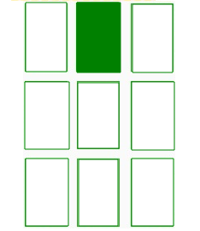
“common”Layout managers
FrameLayout
It is the simplest of the Layout Managers that pins each child view within its frame

Slide 4
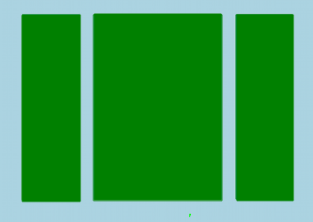
“common”Layout managers
LinearLayout
Arranges its child views either vertically or horizontally.

Slide 5
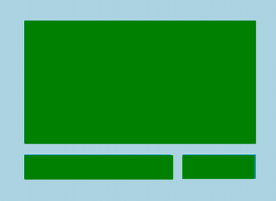
“common”Layout managers
RelativeLayout
Positions views relative to each other or the parent container.

Slide 6

“common”Layout managers
GridLayout
Positions views relative to each other or the parent container.

Slide 7
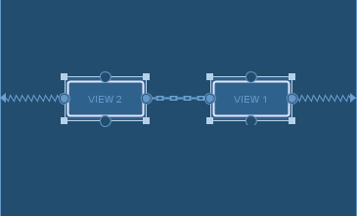
“common”Layout managers
ConstraintLayout
Allows flexible and complex layouts by constraining views to one another in a flat view hierarchy (modern and powerful layout).

Slide 8
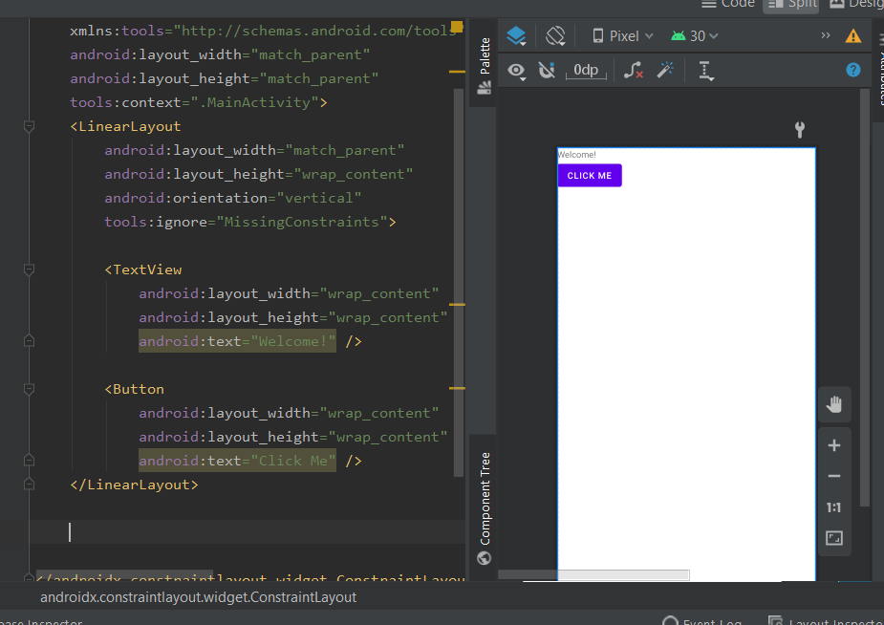
Ex: Linear Layout

Slide 9
Views and ViewGroups
Views
The basic building blocks for UI components like buttons, text fields, images, etc.
ViewGroups
Containers that hold multiple views or other ViewGroups, providing structure for UI layouts, like frameLayout , Scrolliew etc.

Slide 10
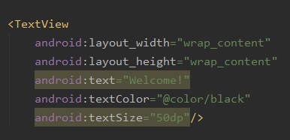
Layout Attributes
Notes:
dp (Density-independent pixels): Use dp instead of px (pixels) to ensure consistent UI scaling across different devices.
sp (Scale-independent pixels): Use sp for text sizes to respect user’s font size settings.
Qualifier Directories: Provide alternate layouts for different screen sizes or orientations (e.g., layout-land/ for landscape mode).

Slide 11
Style and Theme
Instead of repeating XML attributes for every view, you can create styles to define reusable attributes and apply them across your app

Slide 12
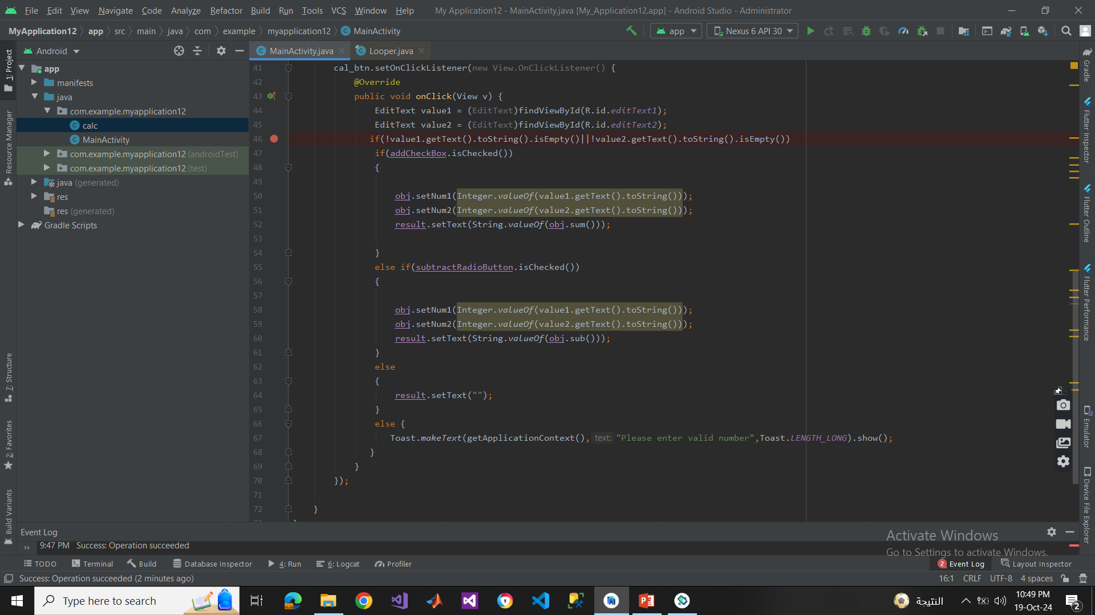
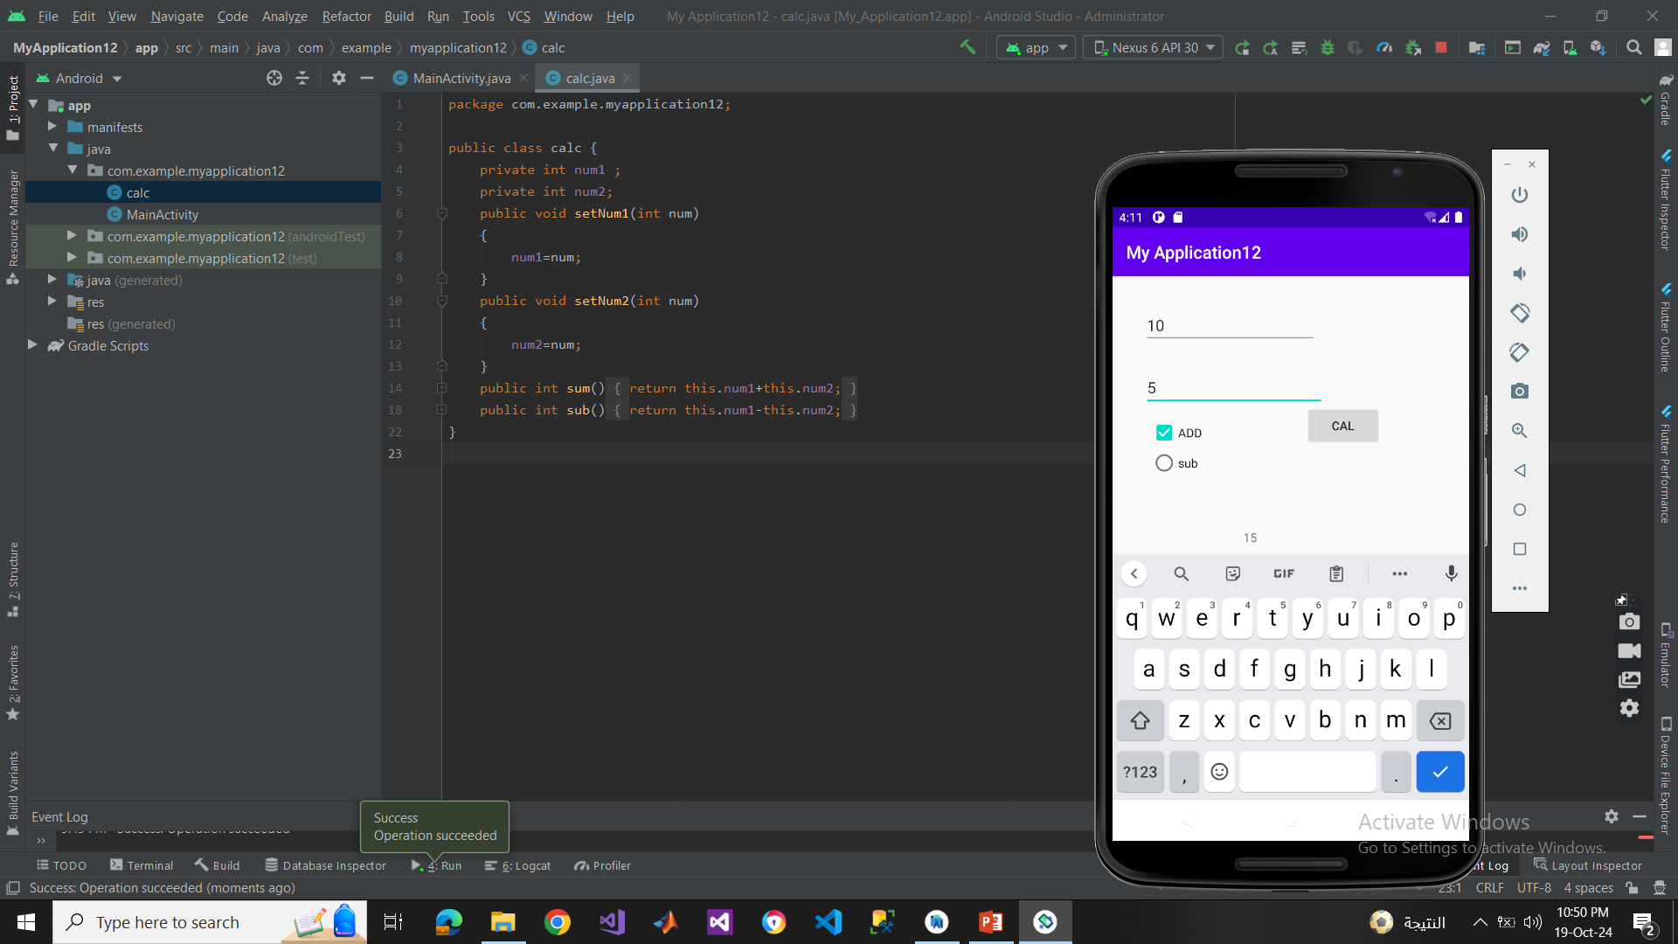
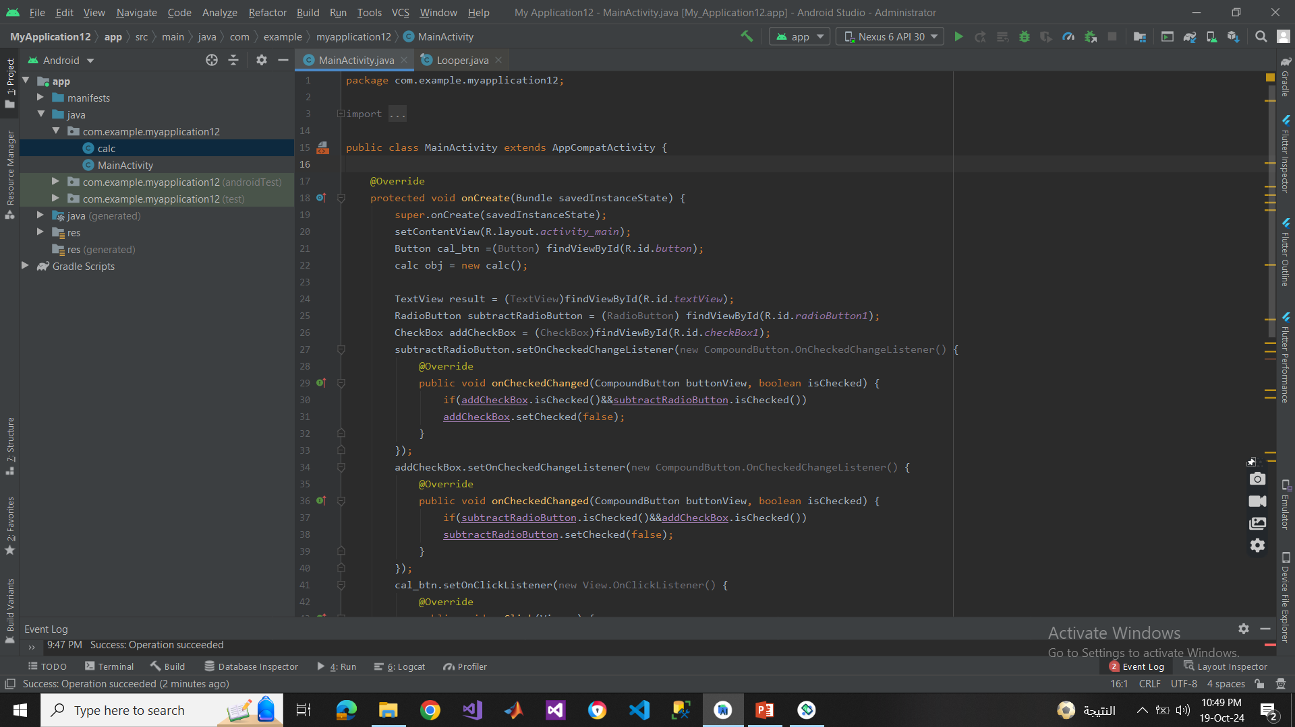
Add & Subtract Example with check box and radio buttons

Slide 13
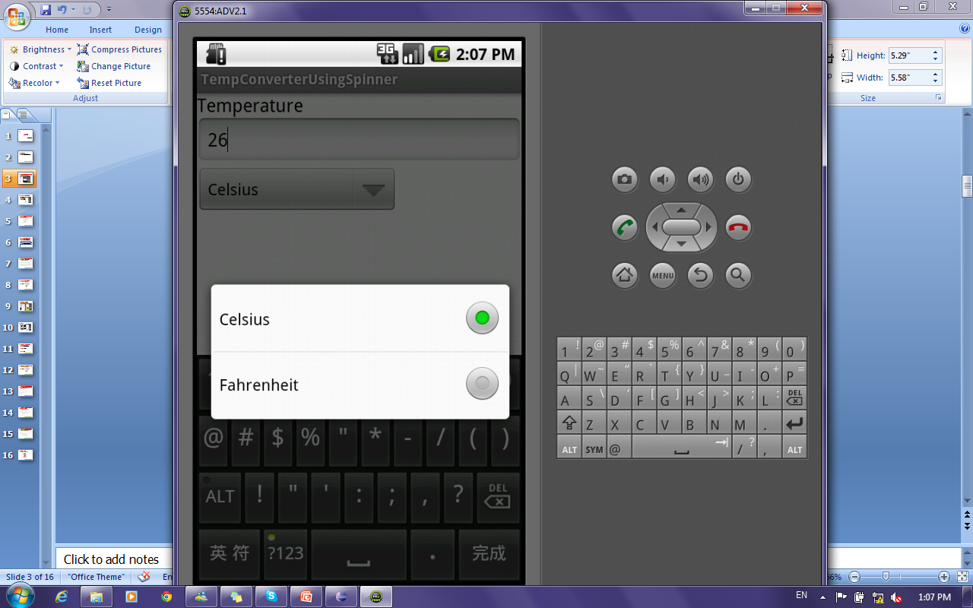
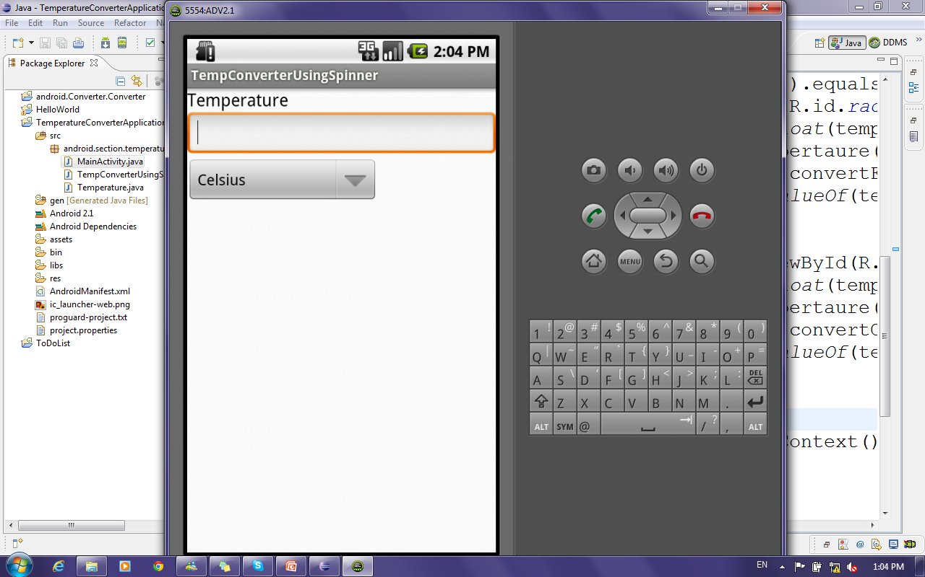
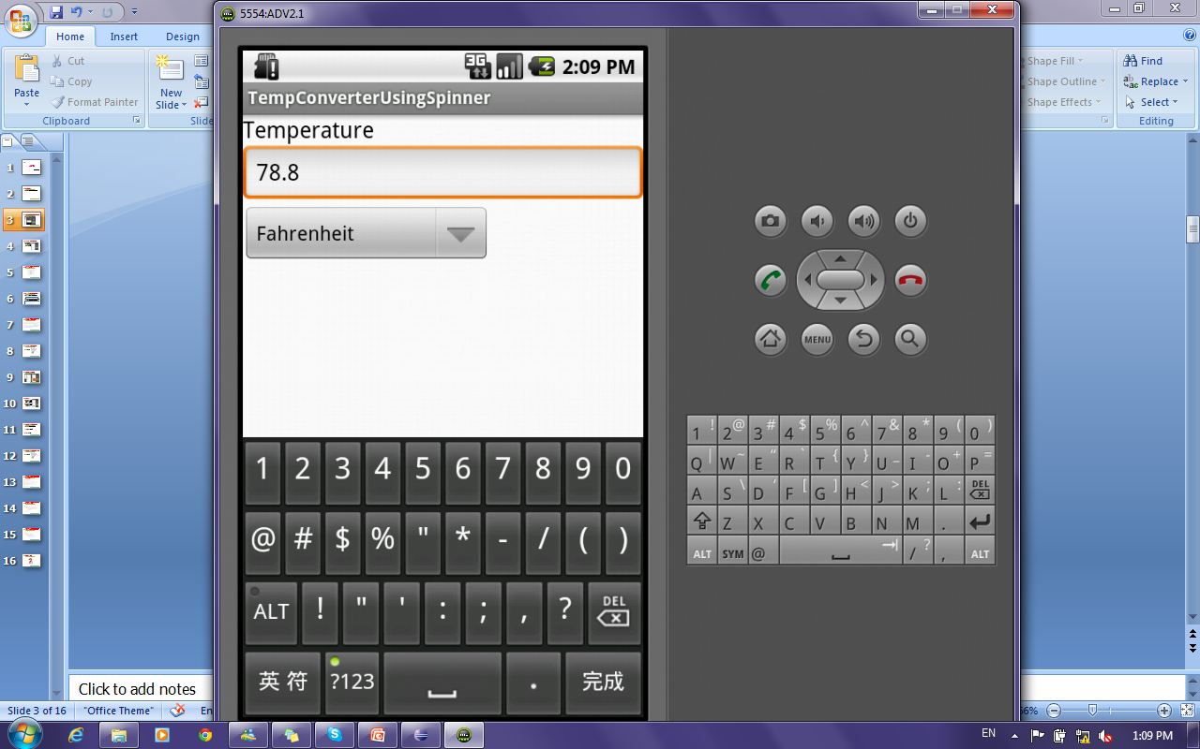
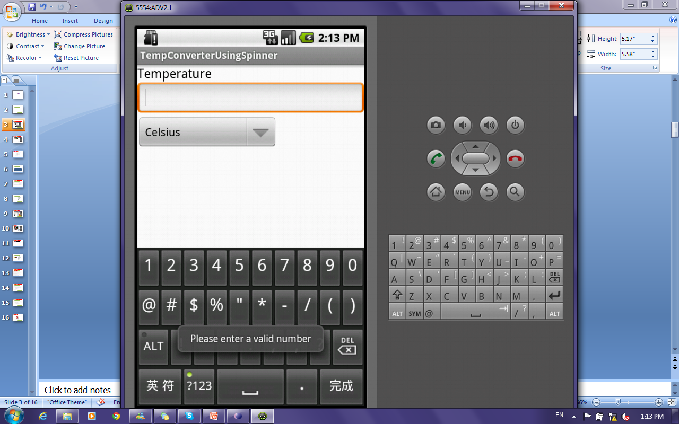
Basics for android: Spinners for Temperature Converter Application

Slide 14
Hands-On
Develop a calculator (sum and subtract using spanners)

Slide 15
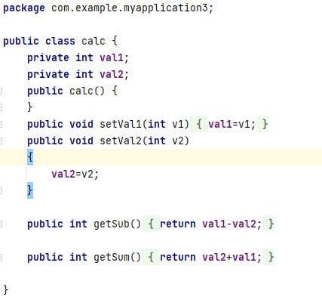
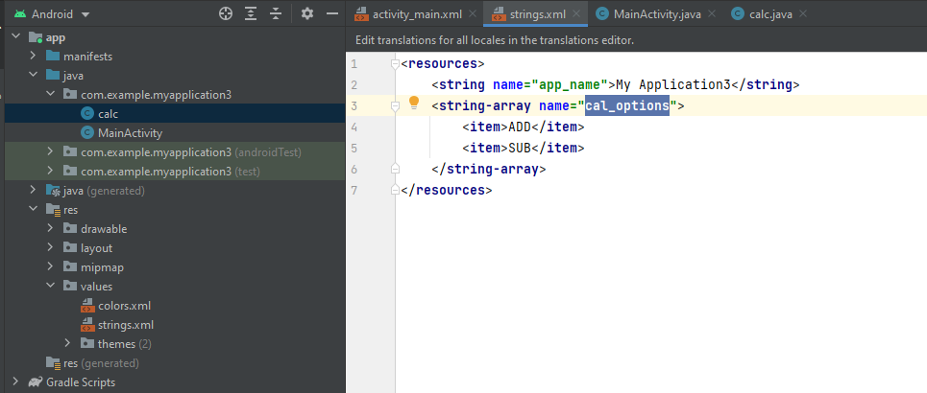

Slide 16
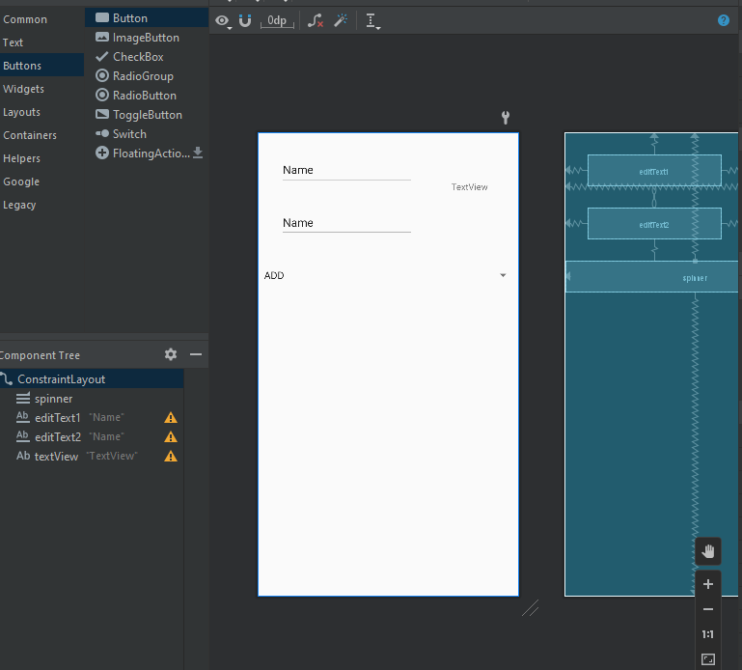
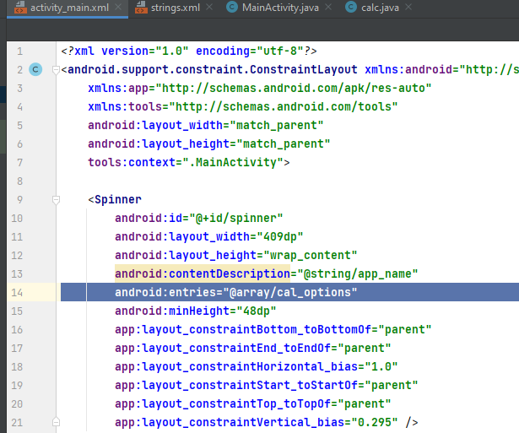

Slide 17
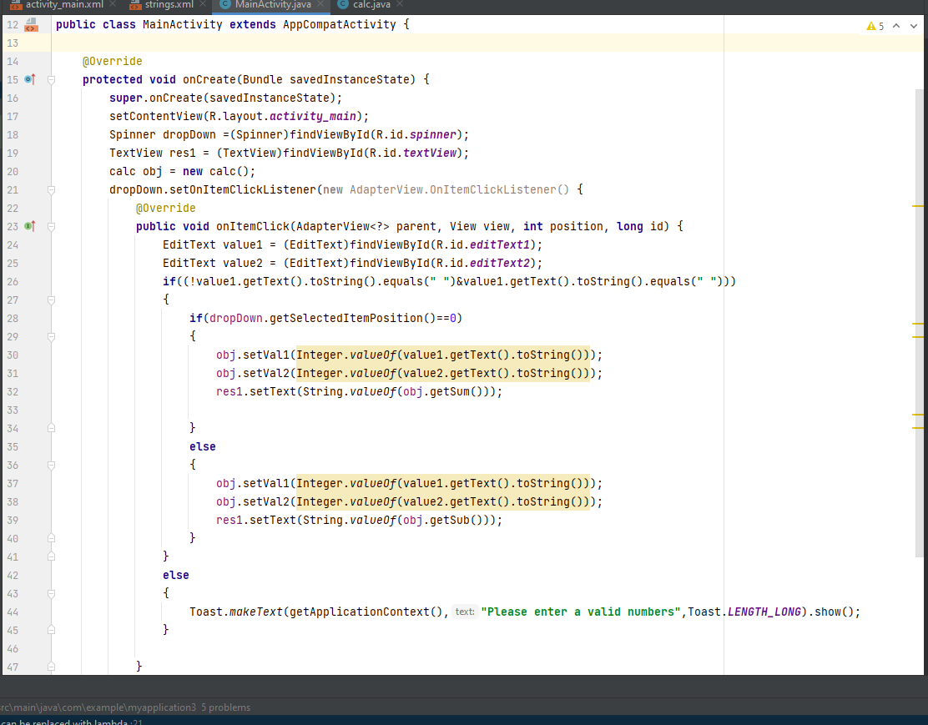

Slide 18
Thank you!

